Slide 1



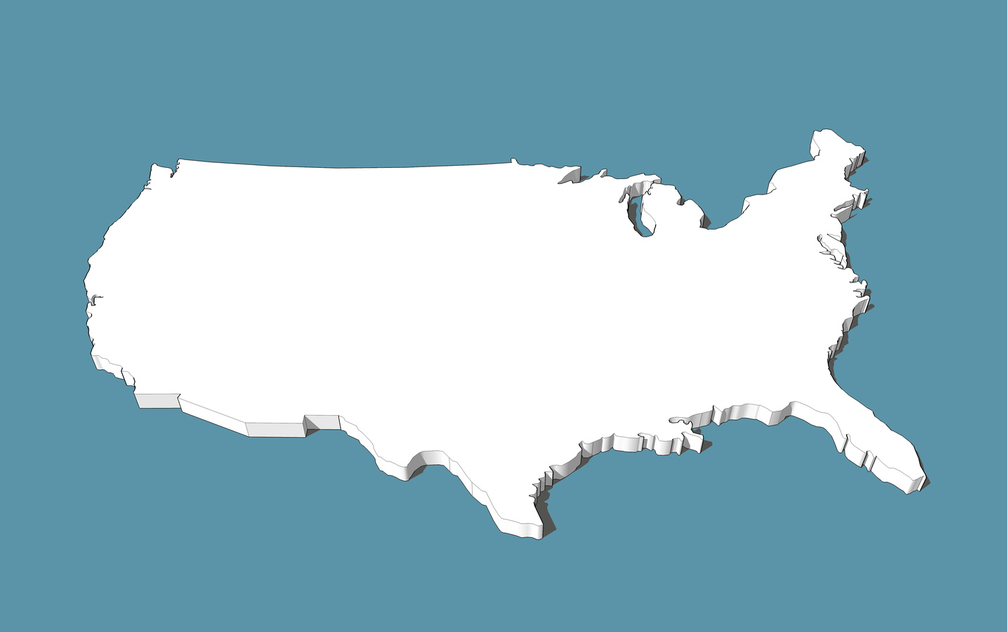


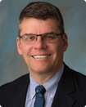
Please Join Us!
Thursday, September 21, 2023
8:00 AM - 3:30 PM
American Family Insurance Headquarters Auditorium
6000 American Parkway, Madison, WI 53783
featuring
Postmaster Louis DeJoy's Video Message
and Keynote Speaker
Steven Monteith,
USPS Chief Customer and Marketing Officer
and Executive VP
Registration
only
$35
www.madisonpcc.com

Slide 2

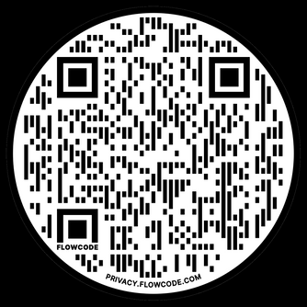
Greater Madison Area
Postal Customer Council
Greater Madison PCC
PO Box 14285
Madison WI 53708-0285
Presort First-Class
Postage & Fees Paid
USPS
Permit No. G-10
DELIVERING FOR AMERICA
National PCC Day
September 21, 2023
8:00 AM - 3:30 PM CST
$35.00 Registration Fee
Scan the QR Code to Register!
www.madisonpcc.com
Get Connected and Grow!

Slide 3
Greater Madison PCC
PO Box 14285
Madison WI 53708-0285
Presort First-Class
Postage & Fees Paid
USPS
Permit No. G-10
National PCC Day
September 21, 2023
8:00 AM - 3:30 PM CST
$35.00 Registration Fee
Scan the QR Code to Register!
www.madisonpcc.com
Get Connected and Grow!

